Slide 1
HTML PARSER
Guided by:
Presented by:
Bibrat Ranjan Pradhan
Rahul Patra
Ronak Thakkar
Sanjay Moharana
7th Semester, B.Tech.,CSEA
Dr. Sarojananda Mishra
HOD, Dept. of CSEA
Mr. Trilochan Kar
Alumnus, IGIT Sarang

Slide 2
CONTENT
Introduction.
Applications.
Components.
Data Flow Diagrams.
Advantages.
Areas of Improvement.
Conclusion.
References.

Slide 3
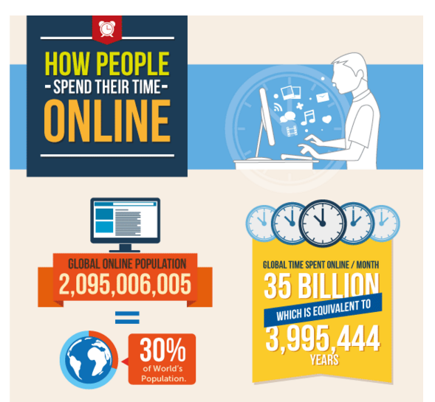
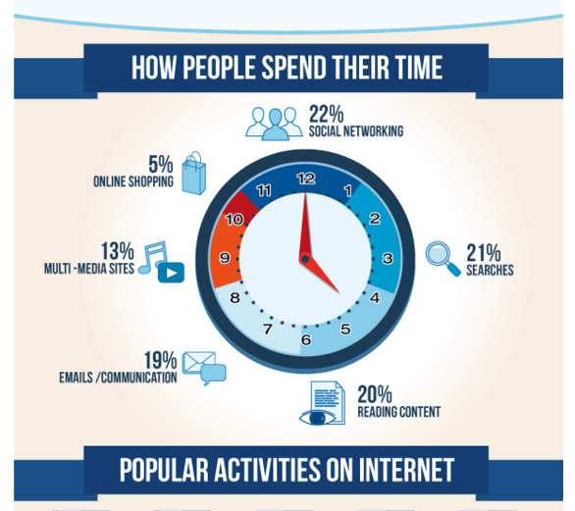
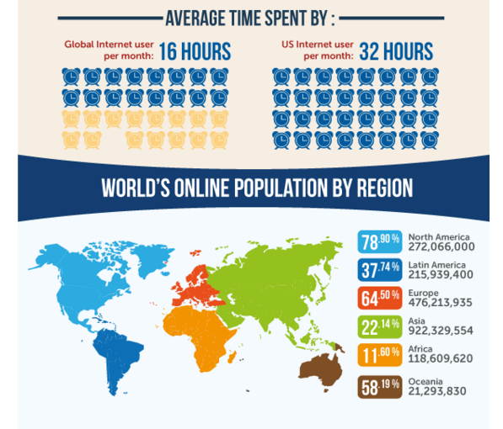

BEFORE DIVING INTO HTML PARSER

Slide 4
INTRODUCTION
The objective is that a user will provide a search string which will be parsed from the given HTML files and the relevant information fetched from it will be stored in a flat file.
This project is java based and will use open and freely available third party APIs to achieve the goal.
This project also aims in improving the parsing technique.
This is a part of a bigger project. This project aims to build a search engine. In this part we are going to build a parser. We will be calling it as HTML Parser.

Slide 5
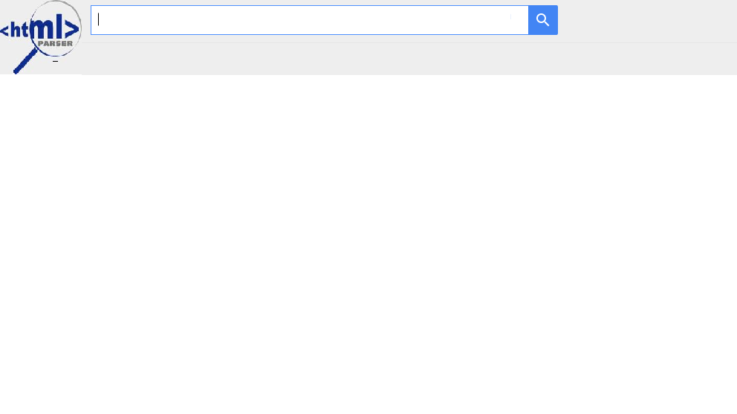
INTERFACE
The INPUT SEARCH STRING goes here
F(x)
F(x) = Parsing logic as well as other logic
The parsed output is stored in a flat file

Slide 6
APPLICATIONS
Web Searching mainly consists of three parts:
Web Crawling
Web indexing
Searching
HTML Parser mainly deals with the Searching part.
It’s a searching mechanism which is currently intended to be used in the local search engine.
It is also used in cleaning the dirty Html files.

Slide 7
COMPONENTS
It mainly consists of three modules
Multithreading
Parsing
File Handling

Slide 8
MULTITHREADING ASPECT
Multithreading is an important aspect in this module.
It will help in fastening up the search process and will hence put less load on the main thread.
As a result, the application will give an effective output.

Slide 9
MULTITHREADING ASPECT (CONT…)
The threads created take up a job one at a time.
The job here refers to taking up an HTML file and reading the contents and parsing it for a given search string. This is the task of a thread from the thread pool. These pool threads are activated by worker threads.
The same thread then performs the task of writing the relevant info onto a flat file.

Slide 10

PARSING ASPECT
Here, Jsoup is used which is a java HTML parser library.
It provides a very convenient API for extracting and manipulating data.
For a given search string, the parser extracts the relevant info.
This relevant information is that content where possible instances of the search string are likely to be present.
Several HTML tags like <div>, <p> etc have been taken up into consideration for extracting information.

Slide 11
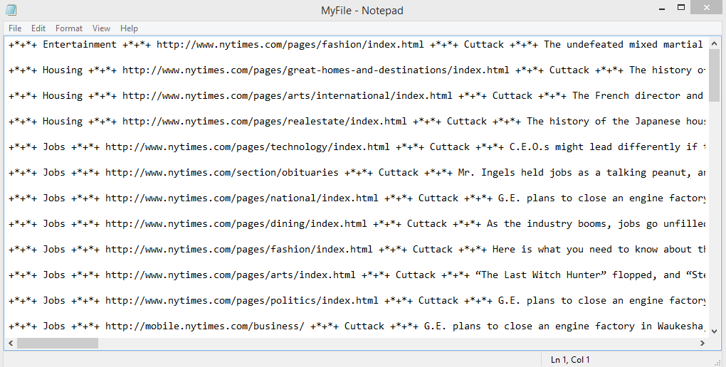
FILE HANDLING ASPECT
Flat File:
In this project a document database is used, which is a flat file.
Advantages:
Speed — without needing to connect to a database to retrieve content, flat-file sites load pages blazingly fast, especially with solid-state drive hosting (referral link)
Simplicity — no need to configure or maintain a database — “installation” is just a matter of uploading file
Version control — everything is just files and folders so it’s easy to version control absolutely everything
Portability — a site can quickly be moved to another server without needing to export and configure a database

Slide 12
USE CASE PACKAGING (CLASS REPRESENTATION)
SimpleThreadPool
main()
WorkerThread
temporaryFileName
FileQ
folderName
Queue
run()
temporaryFileName
putFilesInQueue()
listFilesForFolder()
FileRead
folderName
result
CheckFile
fileName
line
FileWrite
fileName
Write()
text
line
division
para
getUrl()
readContent()
text
checkIfPresent()

Slide 13
ACTIVITY DIAGRAM
Application Starts
Put all HTML files in queue
Thread
Management
Pool Thread
Creation
Worker Thread
Creation
Parsing
(i/p: search string)
Content
Not Found
Get relevant
Content
Get URL
Check For Duplicity
Write Into
Flat File
Duplicate Record
Work Ends
For One Thread

Slide 14
FLAT FILE SCHEMA
SEARCH STRING
URL
RELEVANT INFO
+*+*+
+*+*+
+*+*+

Slide 15
ADVANTAGES
For a given search string, we will be able to have the relevant info. And then use the results further.
Once we get the relevant information we will be able to get the URLs from where these have been extracted. Then we can directly visit that web page.

Slide 16
AREAS OF IMPROVEMENT
It will be helpful if we could have a categorised search which would mean that we will now no longer have to search all the files. It will narrow the searching content and reduces the time complexity.
Multithreading aspect can be a subject of improvement. The aim is again to improve upon the space & time complexity.

Slide 17
CONCLUSION
HTML Parser needs to be used appropriately:
Due to its varied and complex nature, this is a field where expert help is necessary in order to have the most efficient parsing to aid in searching.
Searching is slowly becoming synonymous with our daily lives. Hence this is an area of great research.

Slide 18
REFERENCES
https://docs.oracle.com/javase/tutorial/essential/concurrency/pools.html
http://docs.oracle.com/javase/7/docs/api/java/util/concurrent/ThreadPoolExecutor.html
http://www.ibm.com/developerworks/library/j-jtp0730.html
http://jsoup.org/cookbook.html
Jsoup jar file (version 1.8.3)

Slide 19
Thank You! It has been good building up to this.
Now, If you have got any questions to ask, we’ll be glad to take them up. Shoot!!!

